Slide 1
Smart Manufacturing in the context of the Indian Manufacturing Ecology Background Presentation
© Confederation of Indian Industry

Slide 2
Flow of presentation
Smart Manufacturing – A brief introduction
Smart Manufacturing – Perceived benefits
Smart Manufacturing – Impact on Jobs and Skills
Current state of adoption and readiness of smart manufacturing
Significance of manufacturing to the Indian economy
Transformation requirements

Slide 3
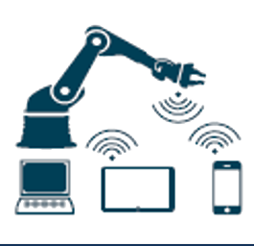
Manufacturing – Facing its 4th Industrial Revolution
A brief introduction
First industrial
revolution
Second industrial
revolution
Third industrial
revolution
Fourth industrial
revolution
1784
1923
1969
2011
Mechanical
weaving loom
Introduction of
mechanical
production assets
based on water and
steam power
Introduction of a "moving'
assembly line at
Ford Motors
Introduction of mass
production based on
division of labor
and electrical
energy
First program-
mable logic
controller (PLC)
Introduction of
electronics and IT
for higher auto-
matizatlon of
production
Smart
Manufacturing
Introduction of
intelligent machines,
embedded cyber-
physical sensors,
collaborative
technologies, and
networked processes
Time
Source: CII – Roland Berger Report 2015
Notes:
The pace of transformation is increasing
The time between industrial revolutions in reducing… earlier it took centuries now it takes mere decades
We are already in the fourth industrial revolution and given the pace of change the fifth industrial revolution will be upon us in the matter of years
Need to open our eyes and realize that change will be the only constant

Slide 4
Smart Manufacturing – Coming together of various technologies
A brief introduction
Fourth Industrial Revolution
Big Data and Analytics
Robots (auto + co-bots)
Simulation
Augmented reality
Horizontal and vertical integration
Industrial Internet of things
Cyber-security
Cloud
Additive Manufacturing
Sensors
Notes:
Certain technologies are driving these transformations
Increasingly we are moving towards the experiential age ,,, various innovations and business models are re-defining manufacturing

Slide 5
Smart Manufacturing – The perceived Benefits
Perceived benefits
Question: What are the benefits that you see resulting from Industry 4.0 advancement?
CII – BCG Manufacturing Leadership Survey 2016
Notes:
- CII – BCG industry readiness survey done last year in November has shown the highest perceived reasons for investing in smart manufacturing is
Improved quality
Lower cost
Flexibility
Although cost and productivity have been the primary drivers of the accelerated adoption of Industry 4.0 in developed countries, quality is the prominent benefit in India.
Despite low labour costs, availability of skilled and quality conscious labour is a major pain point for Indian manufacturers.
As Indian manufacturers move up in the value chain and aim to capture the export market, they need to fill quality gaps through automation and technology adoption. Cost, flexibility and reduced time to market are the second order benefits that Indian manufacturers target beyond quality.
Clearly these 3 factors are what the industry is truly after and Smart manufacturing really and truly enables this…

Slide 6
First movers to smart manufacturing
Current state of adoption and readiness of smart manufacturing
Which industry sector do you think possesses highest potential
in making Industry 4.0 advancements?
CII – BCG Manufacturing Leadership Survey 2016
Notes:
The same survey has revealed that the top industries that are looking to invest in industry 4.0 advancements include Automotive, ESDM, Medical equipment, consumer durables and FMCG.
These select industries also form a significant chunk of the manufacturing sector.

Slide 7
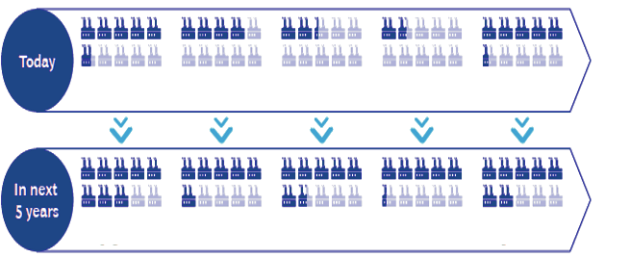
Readiness and openness towards technologies
Current state of adoption and readiness of smart manufacturing
Question : Which pillar of Industry 4.0 are you investing in?
TODAY
56%
38%
23%
15%
54%
Next 5 years
79%
58%
65%
52%
71%
CII – BCG Manufacturing Leadership Survey 2016
7
Notes:
As the adoption of Industry 4.0 technologies accelerates in other countries, Indian manufacturers are drawing a roadmap to incorporate these technologies.
The survey reveals that more than 50% of the manufacturers have either already invested in or are in the process of investing in the majority of the industries smart technologies.
Big data and simulation are technologies that almost two thirds of companies are expected to adopt within the next 5 years

Slide 8
Given the use of new technologies the nature of jobs will change as well …
Current state of adoption and readiness of smart manufacturing
Illustrative
Leading to creation of new jobs
New Industries will spawn
1
New Materials - Composites
1
Artificial Intelligence Developers
2
Drones
2
Robot Manufacturers
3
Driverless cars
3
CAD / CAM Operators
4
Robotics
4
Skill trainers
8

Slide 9
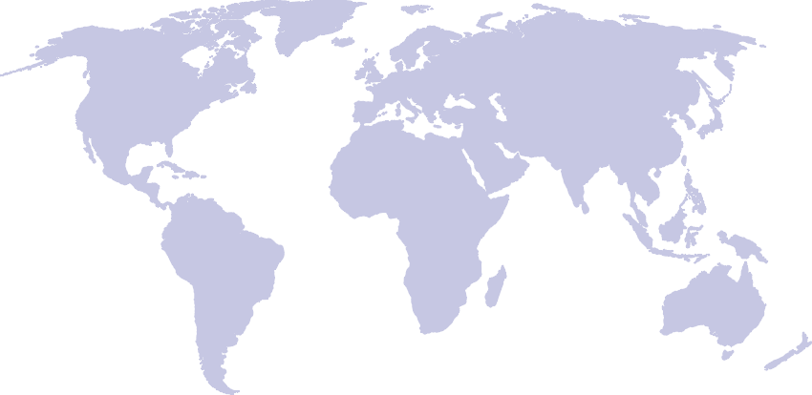
India – one of the fastest growing emerging economy… need to sustain…. Manufacturing key and at heart of our economic security
Significance of manufacturing to the Indian economy
Russia
1.8%
UK
1.7%
USA
2.2%
China
6.8%
Japan
1.5%
India
6.7%
Brazil
0.7%
RSA
0.7%
Emerging Market and Developing Economies – 4.6
Advanced Economies – 2.2
World average – 3.6
Source : IMF: 2016-17
Notes:
India is one of the fastest growing emerging economy… need to sustain this growth …. Manufacturing key and at heart of our economic security

Slide 10
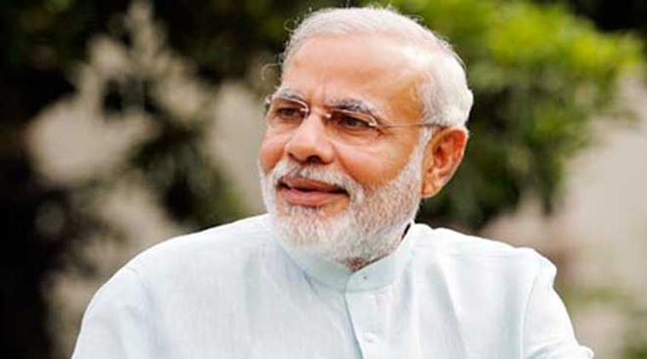
… and, thus, the core of the Hon’ble PM’s Vision for Make in India
Significance of manufacturing to the Indian economy
“If we have to develop a balance between imports and exports, we will have to strengthen manufacturing sector. If we have to put in use the education, the capability of the youth, we will have to go for manufacturing sector and for this Hindustan also will have to lend its full strength, but we also invite world powers. Therefore I want to appeal [to] all the people world over… “Come, make in India”, “Come, manufacture in India”. Sell in any country of the world but manufacture here. We have got skill, talent, discipline, and determination to do something… “Come, Make in India”.
- Excerpt from Hon’ble Prime Minister Shri Narendra Modi’s speech on the Independence day of India, 15 August 2014, New Delhi

Slide 11
And rightly so…
Significance of manufacturing to the Indian economy
Economic activity generated by
$1 of sector GDP
USA | April 2012-2014
$ 1 in manufacturing
$ 1.33 in economy
‘Every job created in manufacturing has a multiplier effect of 2-3X additional jobs in related activities’.
- National Manufacturing Policy 2011, GoI
Figures are as per April 2014
Source US Bureau of Economic analysis, Annual Input – output tables
Notes:
Every dollar invested in manufacturing generates 1.33 dollars in the economy and 2-3 jobs.
Its multiplier effect is the highest

Slide 12
To power India’s economic growth story sustainably…
Significance of manufacturing to the Indian economy
Need to generate 100 million jobs and
increase contribution of manufacturing sector to GDP to 25% by 2025
2025: GDP ~USD 4 Trillion¹ /
INR 250 Lakh Crore
2016: GDP ~USD 2 Trillion¹ /
INR 130 Lakh Crore
Current:
Manufacturing contribution to GDP
16.2% = ~ USD 300 Billion /
INR 20 Lakh Crore
Aspiration:
Manufacturing contribution to GDP
25% = ~ USD 1 Trillion/
INR 65 Lakh Crore
Assuming 7.5% y-o-y GDP growth
Manufacturing sector will need to grow >15% y-o-y to reach 25% of total GDP by 2025
¹ At Current Prices
USD 1 = INR 65
GDP basis GVA calculation methodology
Notes:
Manufacturing needs to go from a USD 300 billion dollar industry to usd 1 trillion dollars
This means an additional contribution of INR 700 billion in the economy
Which means a 2 trillion dollar capex investment
This investment has to be done in latest technologies
Hence smart manufacturing is the new imperative

Slide 13
To achieve this aggressive growth CII proposed the Champions Formula
Transformation requirements
Identify manufacturing industries in which
Strengthen eco-system
Address issues related to
Make it happen
Focus on
Strategically identify specific Champion Industries
- Non-competitive costs
- Encouraging technology Investments
- Appropriately skilling manpower
- Scale and market share
- Platform Innovation
- Brand
- Sustenance
- India could be number 1 or 2 in the next 10 years - can drive double digit growth and significant job creation
- Empowering policies
Enhancing India’s soft power
Notes:
CII has proposed a formula earlier this year.. To help achieve this high growth

Slide 14
28 Champion industries were identified that had the potential to drive significant double growth in manufacturing and employment
Transformation requirements
Sector | Industry
Aerospace & Defence | Aircraft Components and sub-systems
Auto and Auto Components | Auto-Electricals & Electronics
 | Automotive batteries
 | Heavy Commercial Vehicles
 | Construction Machinery
 | Passenger Cars
 | 2/3 wheelers
Cement | Cement
Chemicals | Agro Intermediates
 | Agro Chemicals
 | Basic Polymers and Elastomers
 | Construction Chemicals
 | Other Performance Chemicals
Sector | Industry
Engineering | Pumps and Valves
 | Machine Tools
 | Pressure Vessels
 | Solar PV
ESDM | Conventional Lighting and LED lighting
 | Mobile phones
 | Printed Circuit Boards and sub-assemblies
Pharma | Bulk drugs
 | Generic Pharmaceuticals
 | Pharma APIs
Steel | Flats
 | Forgings and Castings
 | Longs
Textiles | Apparel
 | Made-ups
Notes:
Even identified industries where Government should focus
Clearly several of these are also the ones which are more open to smart manufacturing

Slide 15
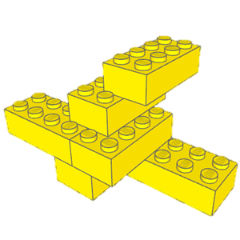
Key interventions required are -
Transformation requirements
Unleashing the
Basic Building Blocks of Manufacturing
Creating a holistic framework for deployment of Smart Manufacturing
1
1
Infrastructure
Cost
2
Policy Regime (including cyber-security)
2
Technology
Z axis
3
Workforce Development
3
Manpower
4
Awareness, tools and metrics
Y axis
4
Policy Regime
Establishing the Drivers for Championing Manufacturing
1
Scale & Market Share
2
Platform Innovation
3
Brand
X axis
4
Sustenance
Notes:
In the Champions formula we had proposed x and y axis to Government.
To further enable the Smart aspect we propose the adding the Z axis – Creating a holistic framework for deployment of smart manufacturing which has 4 components
Infrastructure
Policy Regime
Workforce Development
Awareness, tools and metrics

Slide 16
Creating a holistic framework for deployment of Smart Manufacturing (1/4)
Transformation requirements
Building robust and secure digital infrastructure
Promoting R&D and building advanced manufacturing infrastructure
Development of high grade materials, various technologies that are driving the fourth industrial revolution in the country
1 centre of excellence in each of the IITs / research institutions for developing the driving technologies for smart manufacturing
Access to capital for innovation and research
Growth and promotion of ‘Venture Capital’
Centralized and simpler access to information to ensure efficient utilization of government schemes
Setting up nodal body for rating projects to enable softer loans
Infrastructure

Slide 17
Creating a holistic framework for deployment of Smart Manufacturing (2/3)
Transformation requirements
Primary, secondary and higher education
Start early – promote use of technology in schools by students
Build qualifications for teachers and initiate training
Development of industrial courses in engineering colleges with focus on I4.0 technologies
Crowdsource equipment and content
Environment enabling life-long learning and skill development
Create library of skills
Create on-job skilling opportunities through apprenticeship programs
Workforce development

Slide 18
Creating a holistic framework for deployment of Smart Manufacturing (3/5)
Transformation requirements
Well-established norms (standards) for interoperability
Legal framework to promote and protect innovation
Creating a National Action Plan for Cybersecurity
Employment codes for start-ups (easier hiring / firing)
Elimination of import duties of select hardware / components not manufactured in India
Converge existing Government Technology development / start- up schemes
Mechanism for evaluation of technological innovations
Adequate incentives for copyrights and patents’ act
Policy & Regulatory
Awareness, tools and metrics
Showcase examples on latest use of technology and the benefits accrued through experience / demo centres + smart clinics at cluster level

