Slide 1
Smart Manufacturing in the Process Industry
Sudhir Shenoy, CEO, Dow India
November 15, 2017

Slide 2
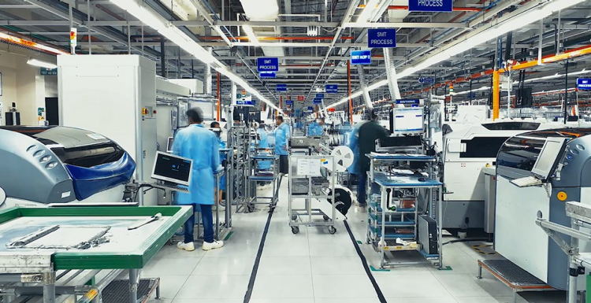
Smart Manufacturing in India – Why and Why Now?
Skill
Skill
Technology
2
Technology
Sustainability
Sustainability

Slide 3
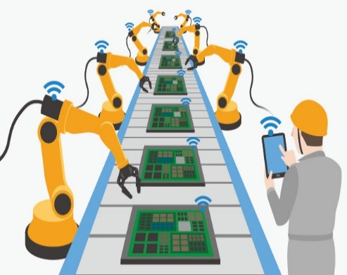
Integration of Technology
High Through-put Research
Supply Chain Excellence
Customer Growth
Technology
Manufacturing
Market Growth

Slide 4
Sustainability : Not just managing output, but also the Input
Circular
Economy
Focus on both productivity and resource optimization
Driving LCA & circular economy in chemical value chain
Zero defect, Zero effect

Slide 5
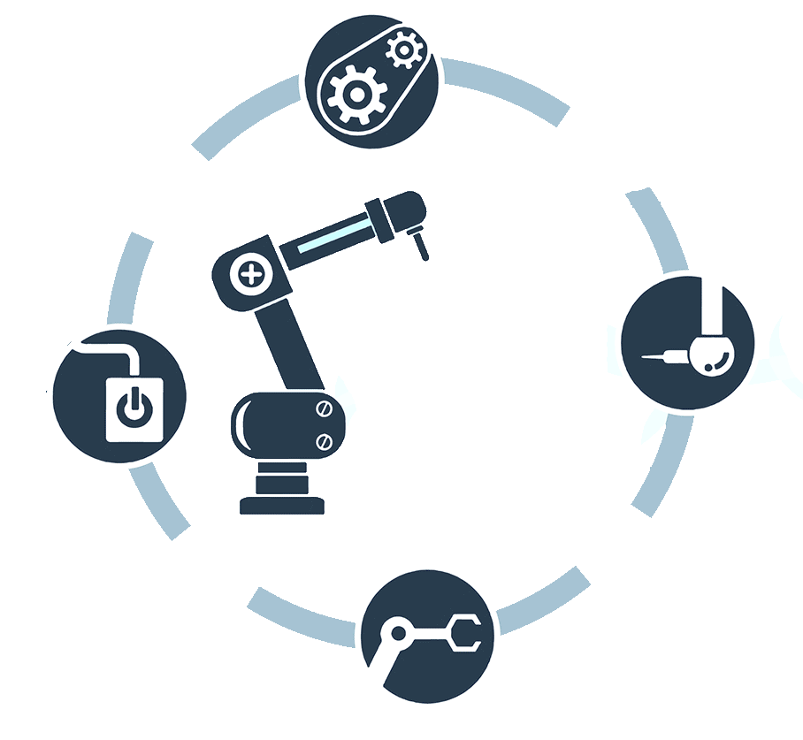
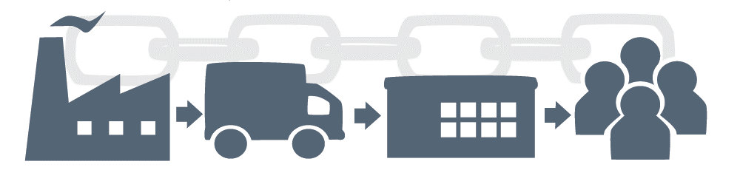
Skill Development and Management
Operations
Advanced
Manufacturing
HR
Training
Safety
technical education leaders
IT
Collaborating with technical education
Skills
Comprehensive consistent upgradation of skills of employees
Manufacturing
Transport
Market
User
Industry – Academia Collaboration

Slide 6
Creating a Blueprint for India
Education
Infrastructure
6
Cybersecurity
Value chain, supply chain and Market growth
Agility on production

