Slide 1
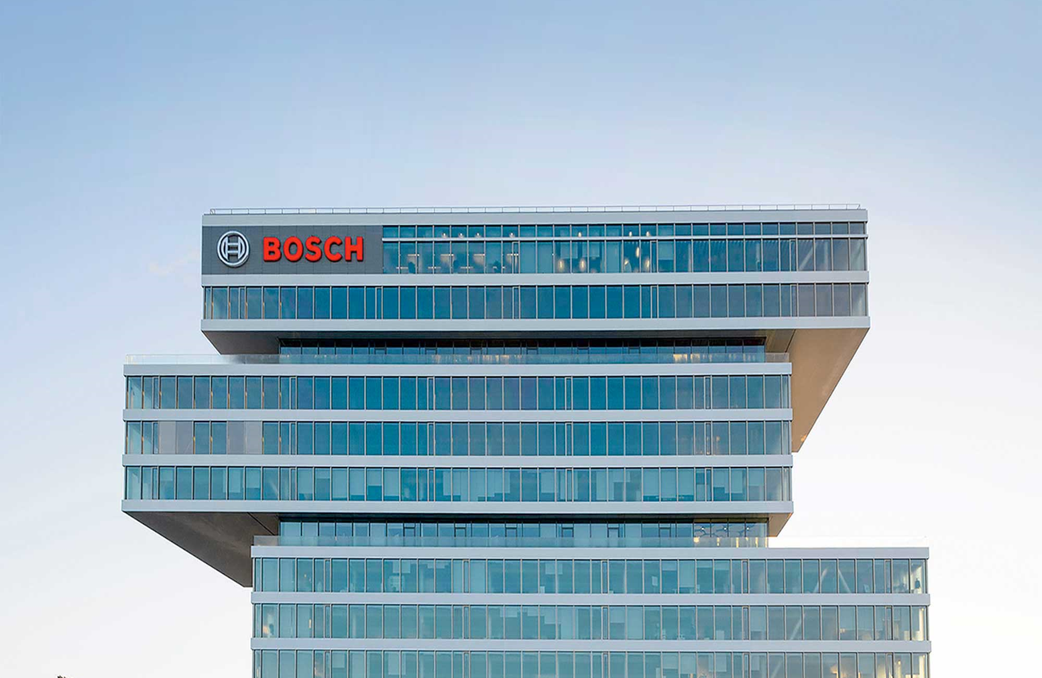
3rd smart manufacturing summit 2017, new delhi, 15.11.2017
With industry 4.0 to Smart manufacturing at bosch
Dr. Michael Loh vice president Manufacturing, Bosch automotive electronics India Pvt Ltd

Slide 2
Our Objective – from Buzz to Reality
With Industry 4.0 to Smart Manufacturing at Bosch
Horizontal integration
Devices
Smart homes
Vertical networking
50Bio. Connected devices
Consumer
Virtual
Information
Web
Data Sharing
Analysis
Marketing
Smart Grid
Energy efficiency
Digital natives
Global
Statistics
Artificial
Social Machines
Applications
Interface
Social Media
M2M
Factory of the future
Multimodality
Exploitation
Sensors
Internet
Real Time
Smart Products
Complexity
Industry 4.0
Automation
Data Collection
Big Data
Internet of Things
Networking
Electrification
Innovation
Apps
Intelligent Systems
Cyber physical systems
Solutions
Stabile Connectivity
Digital Transformation
Cloud
Interconnected
www
Costs
Engineering
HMI
Embedded Systems
Knowledge networks
Productivity
Advanced robotics
2
Real time services
Vision
Automotive Electronics | RBAI/PJ-I4.0 | 15.11.2017
© Bosch Automotive Electronics India Private Limited 2017. All rights reserved, also regarding any disposal, exploitation, reproduction, editing, distribution, as well as in the event of applications for industrial property rights.

Slide 3
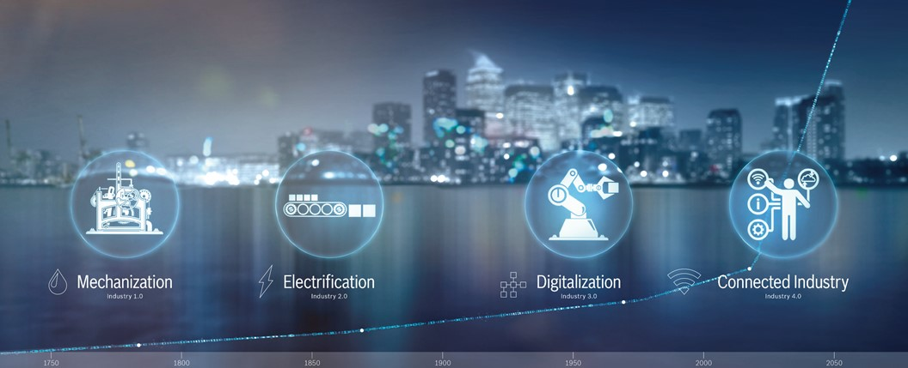
Industry 4.0 – Where Are We?
With Industry 4.0 to Smart Manufacturing at Bosch
3
Automotive Electronics | Dr. Michael Loh | 15.11.2017
© Bosch Automotive Electronics India Private Limited 2017. All rights reserved, also regarding any disposal, exploitation, reproduction, editing, distribution, as well as in the event of applications for industrial property rights.

Slide 4
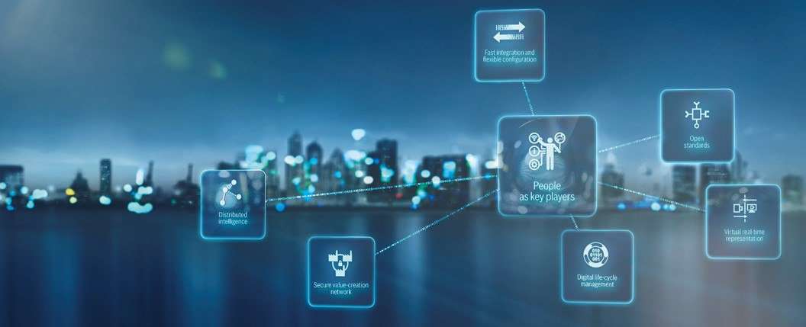
Smart Manufacturing – What Is It?
With Industry 4.0 to Smart Manufacturing at Bosch
4
Automotive Electronics | Dr. Michael Loh | 15.11.2017
© Bosch Automotive Electronics India Private Limited 2017. All rights reserved, also regarding any disposal, exploitation, reproduction, editing, distribution, as well as in the event of applications for industrial property rights.

Slide 5
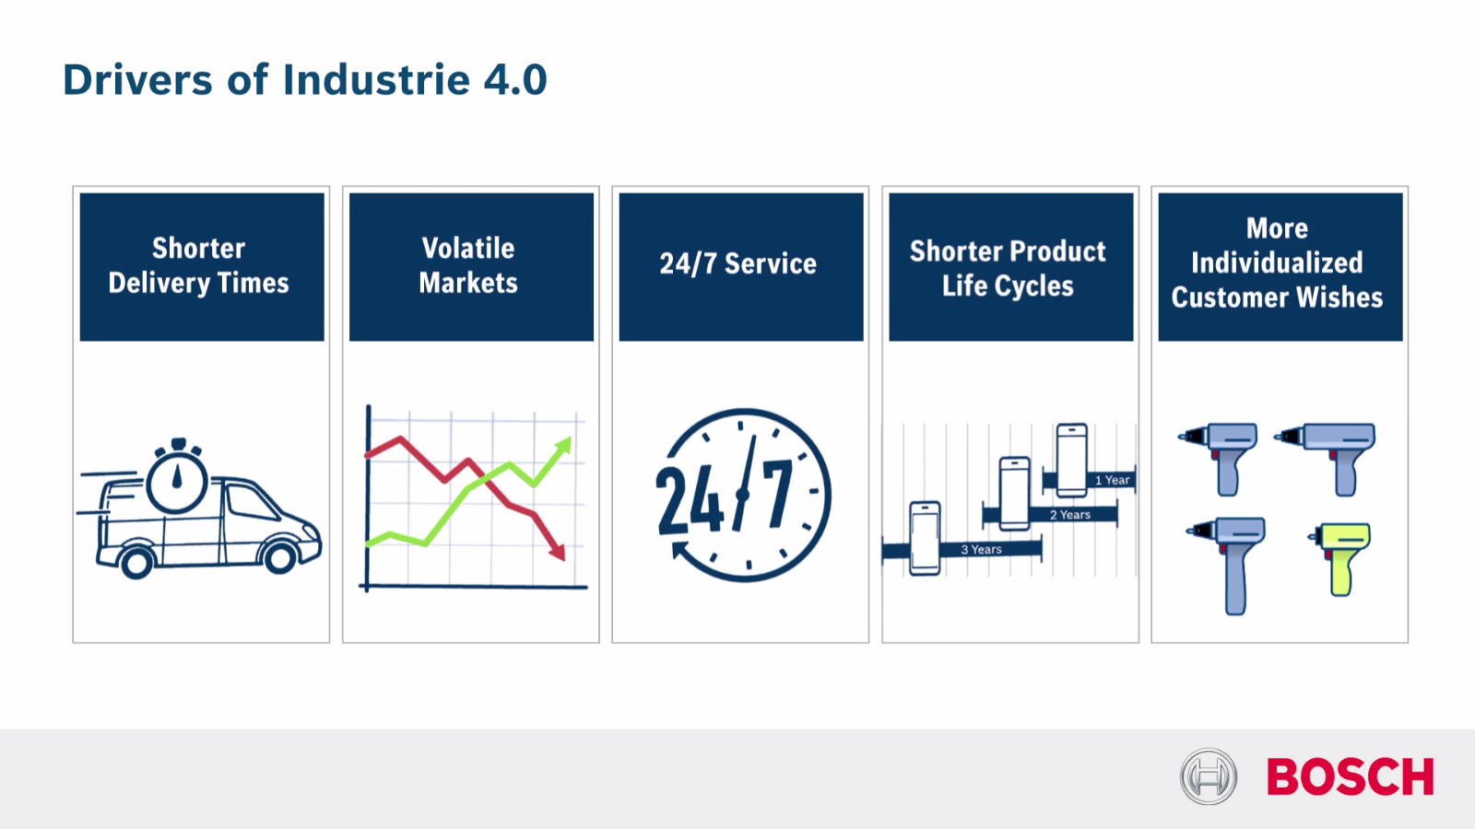
Why Smart Manufacturing ?
With Industry 4.0 to Smart Manufacturing at Bosch
5
Automotive Electronics | Dr. Michael Loh | 15.11.2017
© Bosch Automotive Electronics India Private Limited 2017. All rights reserved, also regarding any disposal, exploitation, reproduction, editing, distribution, as well as in the event of applications for industrial property rights.

Slide 6
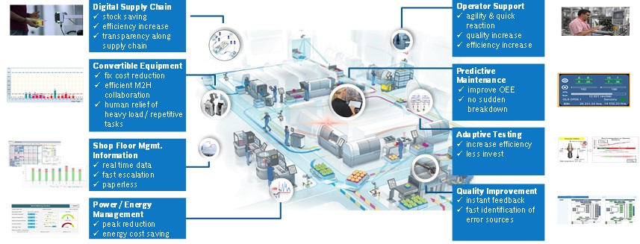
Reality in the Smart Factory
With Industry 4.0 to Smart Manufacturing at Bosch
6
Automotive Electronics | Dr. Michael Loh | 15.11.2017
© Bosch Automotive Electronics India Private Limited 2017. All rights reserved, also regarding any disposal, exploitation, reproduction, editing, distribution, as well as in the event of applications for industrial property rights.

Slide 7
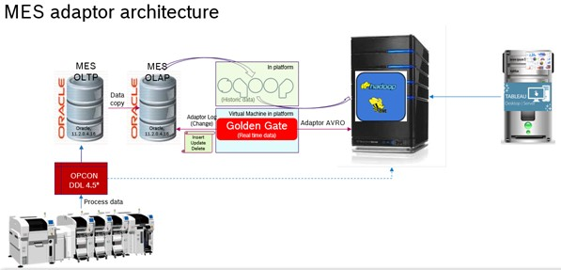
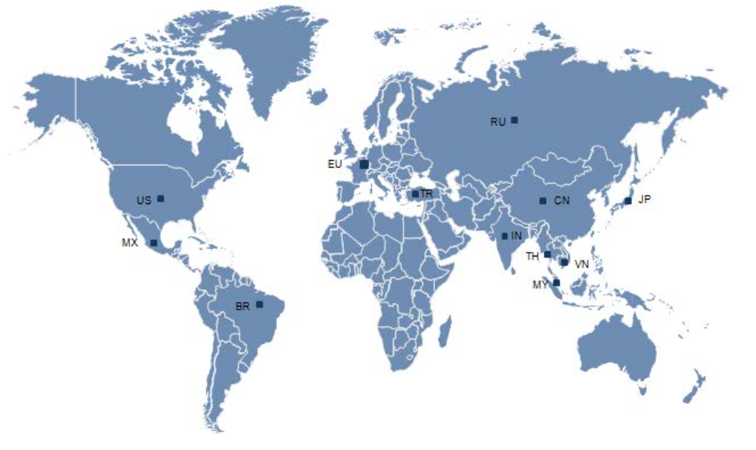

Our Approach to Smart Manufacturing
With Industry 4.0 to Smart Manufacturing at Bosch
Connect
Data driven company
Copy
Deployment of good practices and use cases across Bosch worldwide
Co-Create
Build i4.0 awareness and engaging associates with future technology for future solutions
7
Automotive Electronics | Dr. Michael Loh | 15.11.2017
© Bosch Automotive Electronics India Private Limited 2017. All rights reserved, also regarding any disposal, exploitation, reproduction, editing, distribution, as well as in the event of applications for industrial property rights.

Slide 8
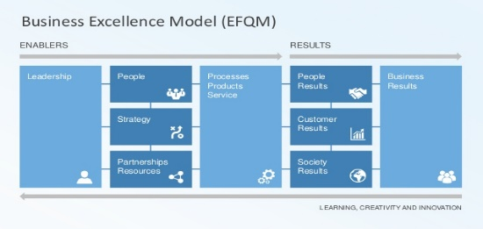
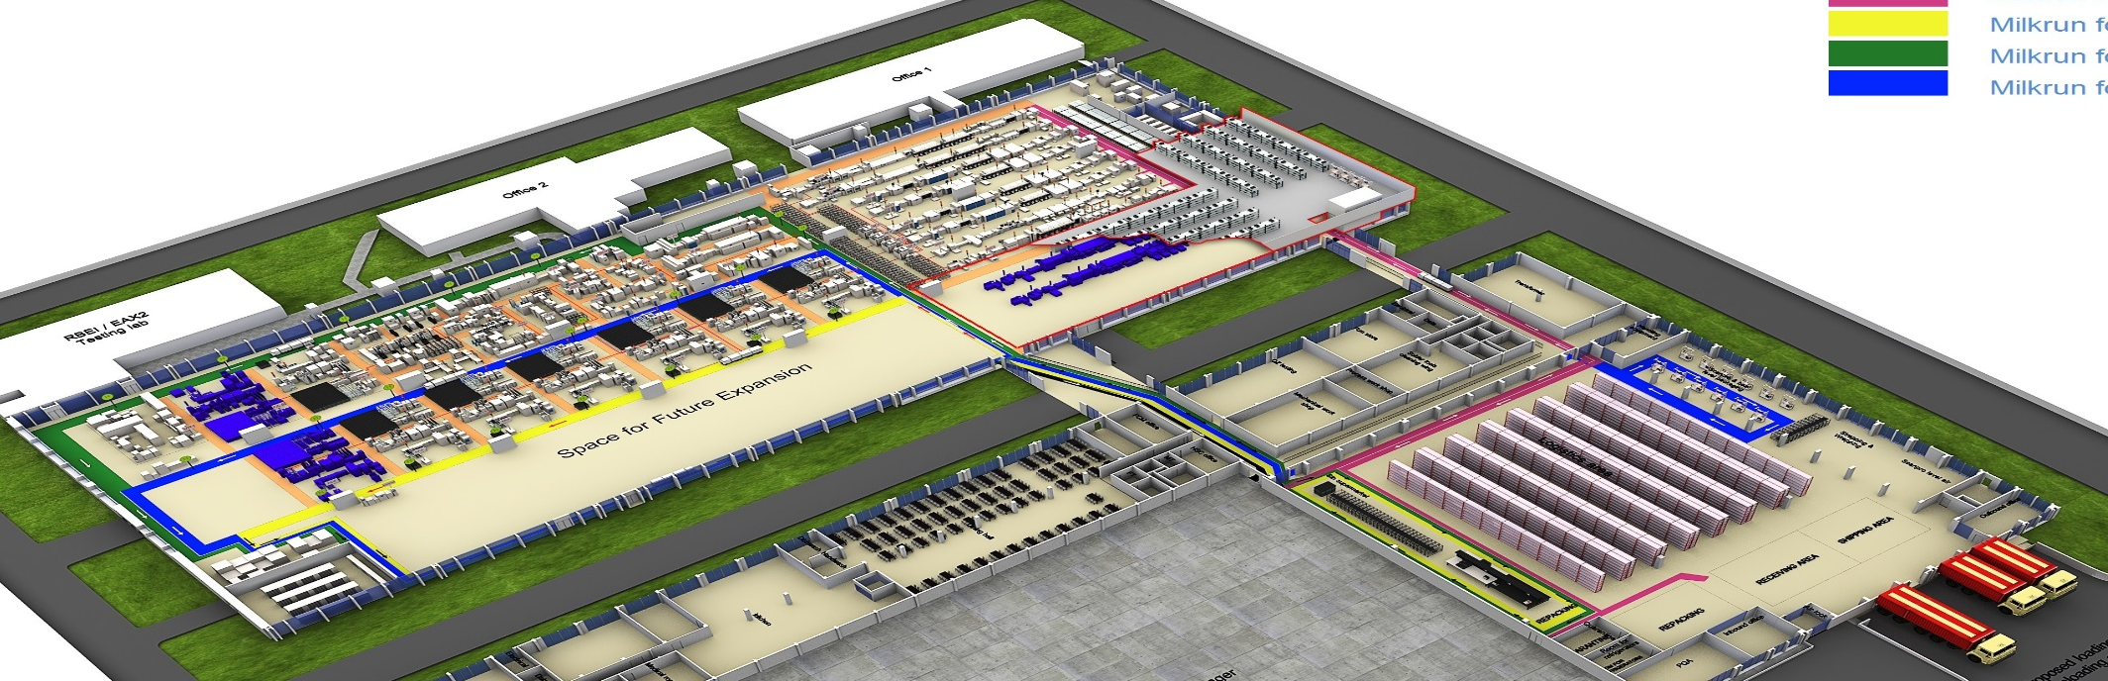
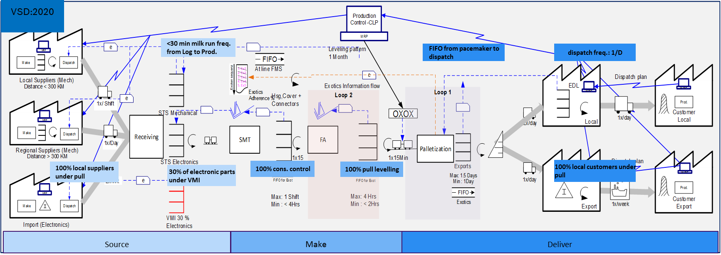

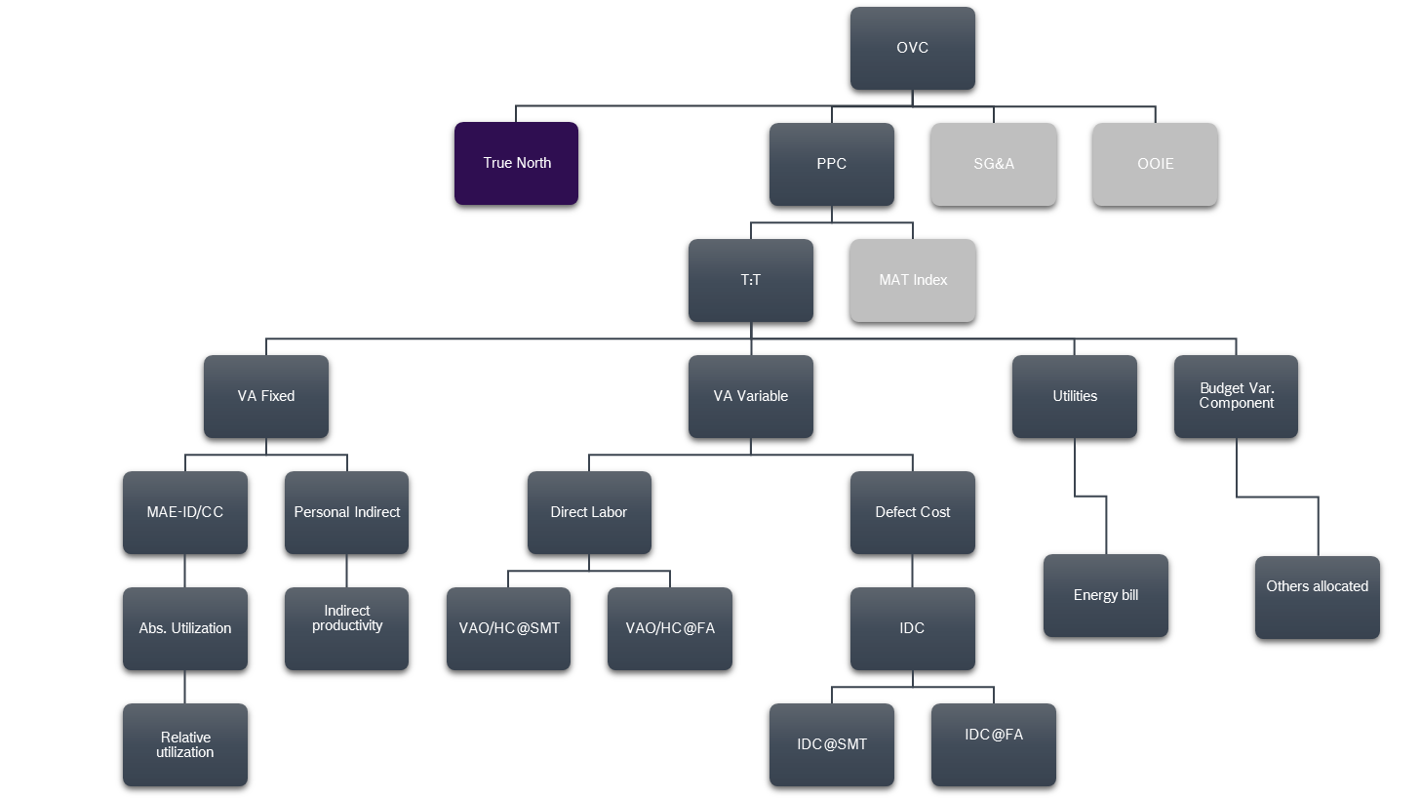
Strategy and Implementation
With Industry 4.0 to Smart Manufacturing at Bosch
Business
Excellence
BPS
KPI
I4.0
Plant vision
Simply
connected
8
Automotive Electronics | Dr. Michael Loh | 15.11.2017
© Bosch Automotive Electronics India Private Limited 2017. All rights reserved, also regarding any disposal, exploitation, reproduction, editing, distribution, as well as in the event of applications for industrial property rights.

Slide 9




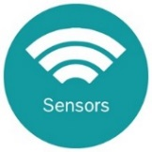
Areas of Application
With Industry 4.0 to Smart Manufacturing at Bosch
Digital Supply chain
RFID – Transport Kanban
E-Kanban with suppliers
E-Kanban with customers
Digital Supply chain
RFID – Production Kanban
BIG data
Process analytics
Energy analytics
Applications
Golden gate
e-ISIR
Training qualification system
Sensor Kit
CISS
XDK
Visualization
NGPro+Tableau
Shop floor management
Active cockpit
Technology
Milk-run adherence system
Window time tracking
Attendance and skill mapping
Paperless production
i-station
Auto change over
Real time representation
Cycle time monitoring
Process capability
Applications
CAVIS
Calibration management
Shop Floor Management
Left over Management
MES
SAP connectivity
Visualization
Super market visualization
9
Automotive Electronics | Dr. Michael Loh | 15.11.2017
© Bosch Automotive Electronics India Private Limited 2017. All rights reserved, also regarding any disposal, exploitation, reproduction, editing, distribution, as well as in the event of applications for industrial property rights.
*Based on I4.0 Platform

Slide 10
Return on Invest from Every Solution
With Industry 4.0 to Smart Manufacturing at Bosch
10
Automotive Electronics | Dr. Michael Loh | 15.11.2017
CF09 / BP18 = Cost vol in TINR
© Bosch Automotive Electronics India Private Limited 2017. All rights reserved, also regarding any disposal, exploitation, reproduction, editing, distribution, as well as in the event of applications for industrial property rights.

Slide 11
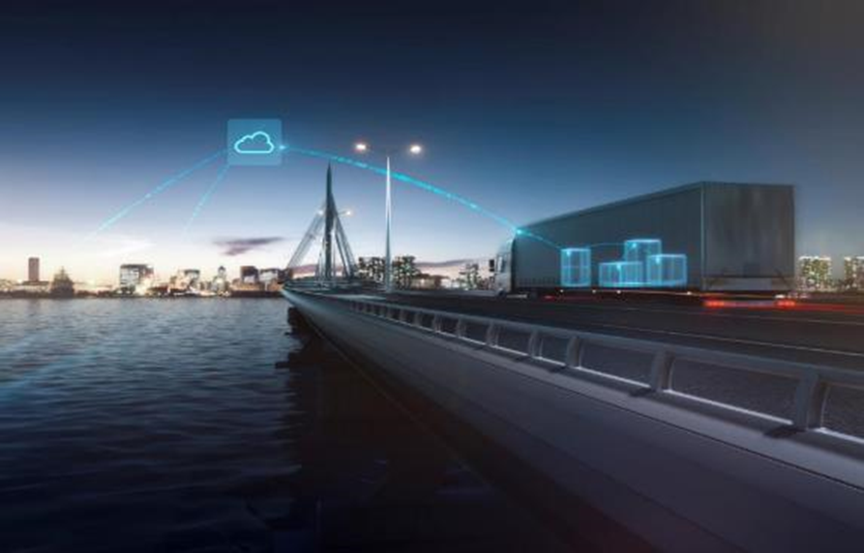
Example –
Block Chain
With Industry 4.0 to Smart Manufacturing at Bosch
11
Automotive Electronics | Dr. Michael Loh | 15.11.2017
© Bosch Automotive Electronics India Private Limited 2017. All rights reserved, also regarding any disposal, exploitation, reproduction, editing, distribution, as well as in the event of applications for industrial property rights.

Slide 12

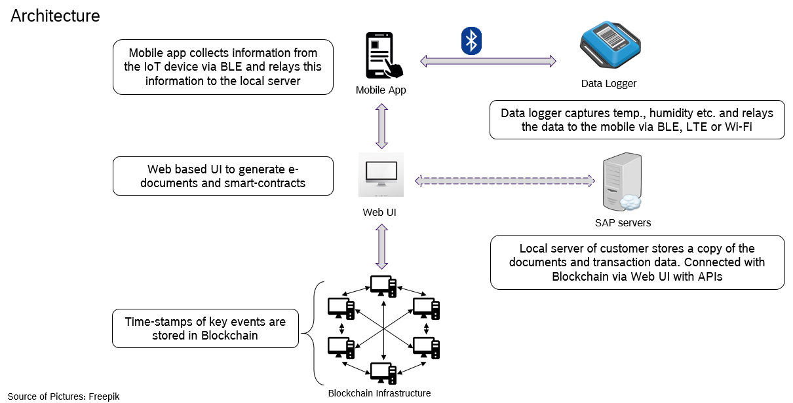
Example – Block Chain
With Industry 4.0 to Smart Manufacturing at Bosch
12
Automotive Electronics | Dr. Michael Loh | 15.11.2017
© Bosch Automotive Electronics India Private Limited 2017. All rights reserved, also regarding any disposal, exploitation, reproduction, editing, distribution, as well as in the event of applications for industrial property rights.

Slide 13
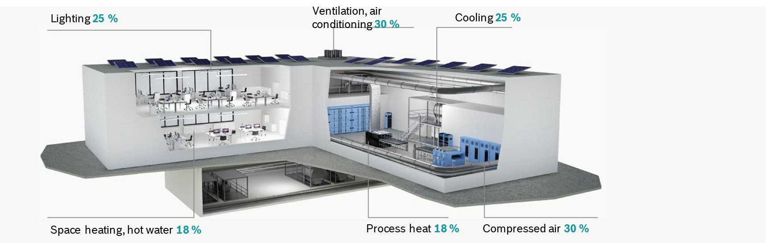
Example – Energy Management
With Industry 4.0 to Smart Manufacturing at Bosch
Energy Savings Potential
13
Automotive Electronics | Dr. Michael Loh | 15.11.2017
© Bosch Automotive Electronics India Private Limited 2017. All rights reserved, also regarding any disposal, exploitation, reproduction, editing, distribution, as well as in the event of applications for industrial property rights.

Slide 14
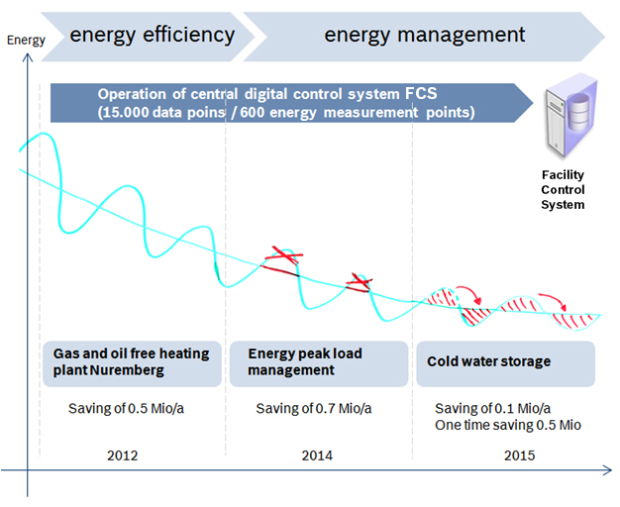
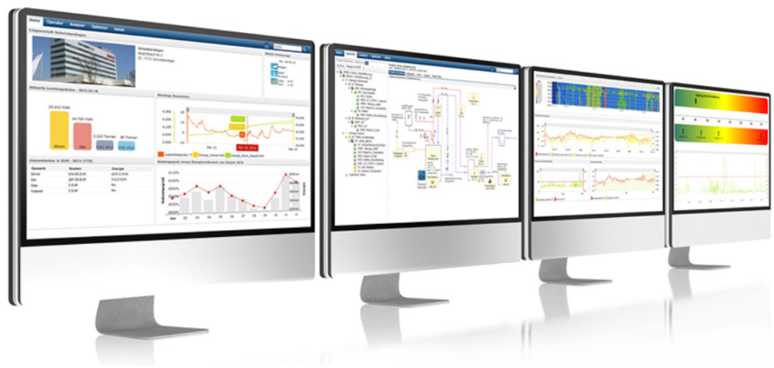
Example – Energy Management
With Industry 4.0 to Smart Manufacturing at Bosch
14
Automotive Electronics | Dr. Michael Loh | 15.11.2017
© Bosch Automotive Electronics India Private Limited 2017. All rights reserved, also regarding any disposal, exploitation, reproduction, editing, distribution, as well as in the event of applications for industrial property rights.

Slide 15
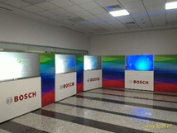
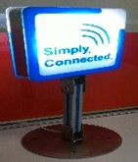
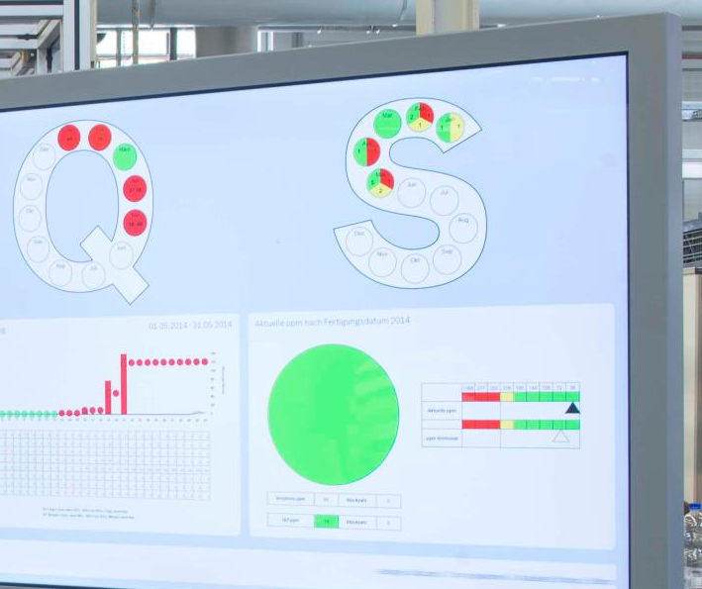
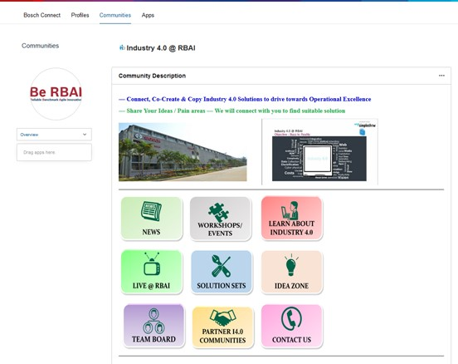
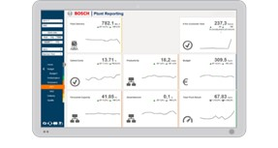
Co-Create – Industry 4.0 Live
With Industry 4.0 to Smart Manufacturing at Bosch
i4.0 experience room
Shop floor displays
BOSCH connect
KPI visualization
Sign boards placed across shop-floor for i4.0 identity
Daily management boards @ Shop floor for respective value streams
Associate awareness and engagement
15
Automotive Electronics | Dr. Michael Loh | 15.11.2017
© Bosch Automotive Electronics India Private Limited 2017. All rights reserved, also regarding any disposal, exploitation, reproduction, editing, distribution, as well as in the event of applications for industrial property rights.

Slide 16
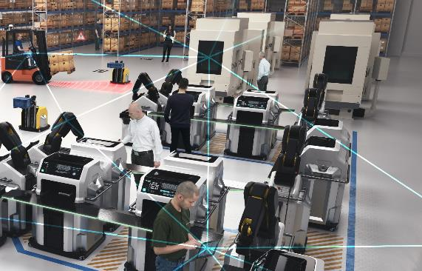
Again – What role will people play?
With Industry 4.0 to Smart Manufacturing at Bosch
In the Industry 4.0 age, people will ...
... contribute their flexibility
... form intelligent teams together with
connected objects
... experience everyday convenience and a reduced workload, and expand their job profiles
... also benefit from technology that is “Invented for life”
16
Automotive Electronics | Dr. Michael Loh | 15.11.2017
© Bosch Automotive Electronics India Private Limited 2017. All rights reserved, also regarding any disposal, exploitation, reproduction, editing, distribution, as well as in the event of applications for industrial property rights.

Slide 17
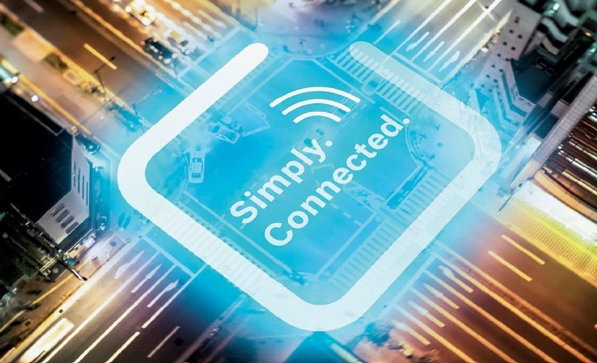

Thank You!
  Industry 4.0 is our Enabler for Business Excellence
  Industry 4.0 Drives Improvement of Quality, Cost, Delivery
  Return on invest confirmed !
  Industry 4.0 is a people`s business
  People play the decisive role in a connected plant !
17
Automotive Electronics | RBAI/PJ-I4.0 | 15.11.2017
© Bosch Automotive Electronics India Private Limited 2017. All rights reserved, also regarding any disposal, exploitation, reproduction, editing, distribution, as well as in the event of applications for industrial property rights.

