Slide 1
Adoption of Industry 4.0 in India – Opportunities & Challenges
Dr. Chandan Chowdhury, Practice Professor (Operations Management & Information System) & Associate Dean, ISB
Executive Director, Munjal Institute for Global Manufacturing and Punj Lloyd Institute of Infrastructure Management
Email: chandan_chowdhury@isb.edu; Mobile: +919810043378; Twitter:@dr_chandan_c

Slide 2
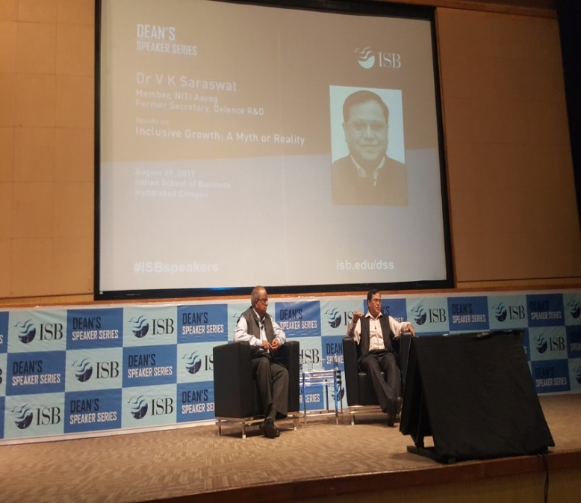
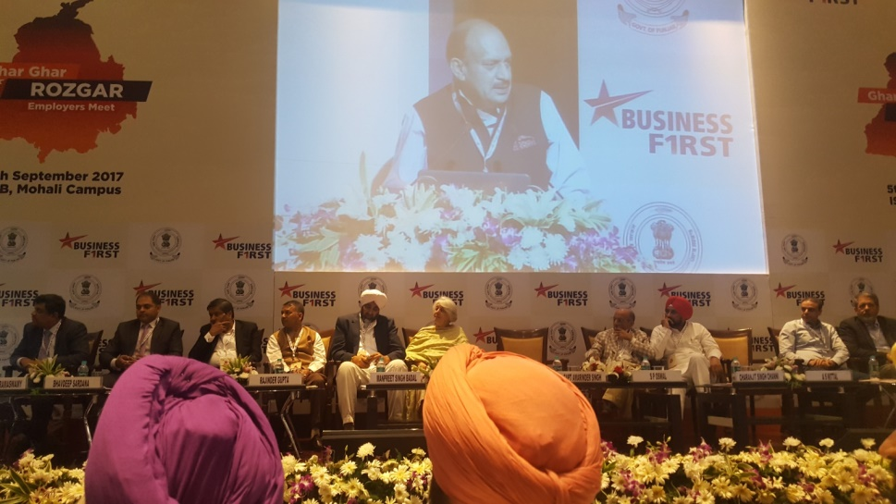
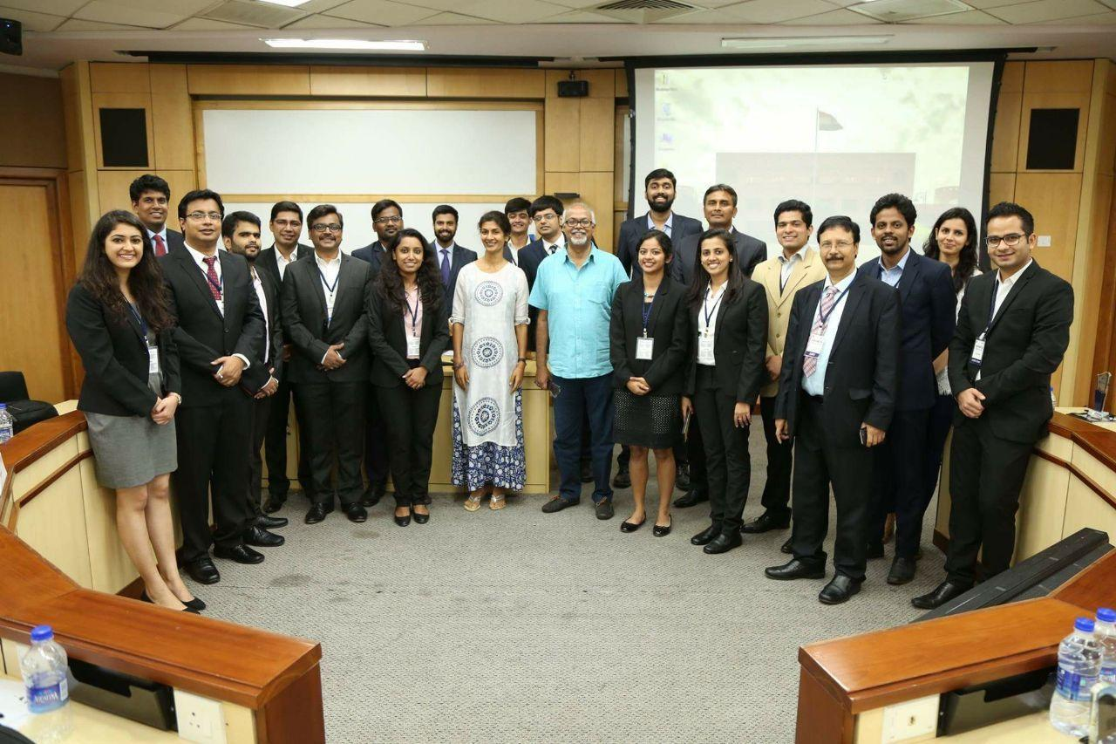
Listening to the Voice of the Government, Policy Makers, Corporates, & Academia

Slide 3
Digital Transformation of Value Chain By Leveraging Industry 4.0
National level competition (696 participants, 232 teams, 79 B-Schools;
top 4 teams presented at ISB)
Automotive & FMCG
Value chain before and after transformation
Business benefits
Job loss and new types of skilling requirement
Ongoing 6 industry projects

Slide 4
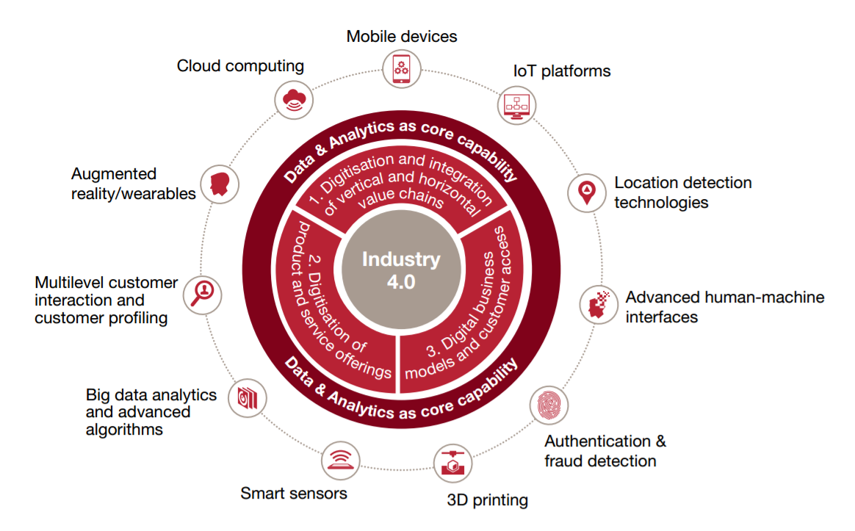
Leveraging Industry 4.0-Challenges & Opportunities
An organization can drive both revenue & margin by leveraging Industry 4.0
Transformation opportunity: both biz. models and biz. processes
Digital maturity-digital intensity & transformation management
Enablement on ‘new skills’ fundamental
Digital-niche to ‘must have’ skills

Slide 5
Thank You

Slide 6
BACKUP SLIDES

Slide 7
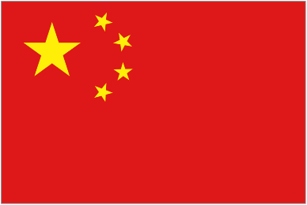
World “Growth” Initiatives
Produktion
2030
Smart
Industry
Made
Difference
Industrial Internet Business Revolution
High Value
Manufacturing
Industry 4.0
Industry of the Future
Digital Manufacturing for SME
Manufacturing Renaissance
Innovation 25’ Program
Fabricacion
Avanzada
Produktionder Zukunft
Made In China 2025
Operational Programme
Fabbrica
Intelligente
Make in India
Precision
Manufacturing

Slide 8
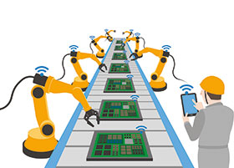
Industry 4.0
Stronger Customer Centricity
More Efficient Production Processes
Agility
Efficiency
INDUSTRY
4.0
Value Chain Transformation through Networked Processing & Objects
2019
Innovation
New Marketing & Business Models

Slide 9
Changying Precision Technology Company (Smart phone manufacturer)
 | Before | After
Number of employees | 650 | 60
Number of robots | 0 | 65
Defects (%) | 25% | Below 5% (80% reduction)
Production per person | 8000 | 21000 (more than 2.6 times)

Slide 10
Key components of current value chain
Tier 1 Suppliers
- Manufacture and supply subsystems to OEMs
- Located closer for enabling JIT
Tier N Suppliers
- Supply to tier 1
- Raw materials
- Located strategically to benefit from scale
Manufacturer
- High capex involved
- Covers a large geographical area
Channel Member
- Customer Facing
- Handles financing and insurance needs
- Some marketing efforts
Logistics
- Transport from OEM to the distributors/Dealer
After Sales Support
- Post Sale Customer Service
- On-Road Repair and Maintenance assistance
Source : engineersjournal.ie

Slide 11
Integrated reengineered value chain
Tier N Suppliers
Advanced Manufacturing Systems
Tier 1 Suppliers
- Fully integrated Supply Chain
- Perfect Coordination
Sensors
- Traceability
- Predictability
Manufacturer
3D Printing
- Scrap Elimination
- Customization
Alternate Resources
- Wind
- Solar
- Nuclear
Cloud Computing
- Big Data
- Cyber Security
Logistics
- Network Optimization
Robotics
- Autonomy
- Productivity
Channel
Member
After Sales Support

Slide 12
IoT will revolutionize the industry
Technology
Robotics – Replacing humans on assembly line
3D Printing – Manufacturing customized components
Big Data – Collecting performance parameters
Analytics – Understanding collected data
Process
Constant communication – Data exchange between components
Decentralized decision making – Routine decisions
Standardization – Ease of customization
Smart Transport System - Automated transportation of raw material / final products
People
Increased efficiency – Reduction in labor per unit
Skill Development – Up-skilling, Re-skilling, Continuous learning & Mindset change
Only to handle disruptions – Monitoring and corrective actions

Slide 13
Nearly Half of Companies Say They Don’t Have the Digital Skills They Need by Jeremy Goldman
After all, in just one decade the concept of “digital” has changed from a ‘niche skill set’ to something that’s ‘mandatory’ for virtually all blue-chip companies.
Employees’ digital IQs have become critical

