Slide 1
Maruti Suzuki India Limited
From FAST to
being SMART
Presented by
Chegu Dhanumjaya, Vice President

Slide 2
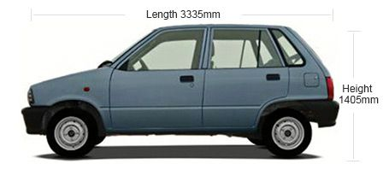
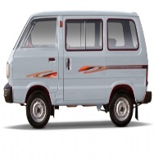
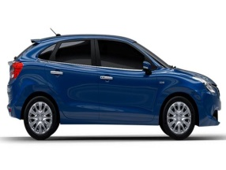
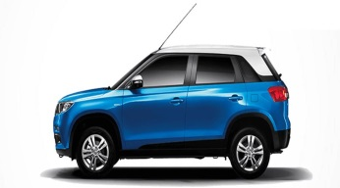
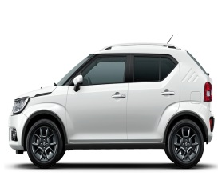
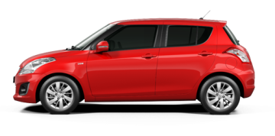

Maruti Suzuki Journey
1983
1996
2010
2016
1983
Launched Maruti 800
One Model
Installed Capacity : 40,000 Cars
1996
1.5 million vehicles rolled out
Seven Models
Installed Capacity : 200,000 Cars
2010
1 million vehicles Produced in a financial year
2016
7 out of 10 top selling models

Slide 3

Our Core Strength is “Manufacturing”
16 models & 1,075 variants through ….
1.5mn vehicles/annum combined capacity of Gurgaon + Manesar
2,400+ robots
10 Kilometers length of running conveyors
A car rolling out in every “9.93 seconds”

Slide 4
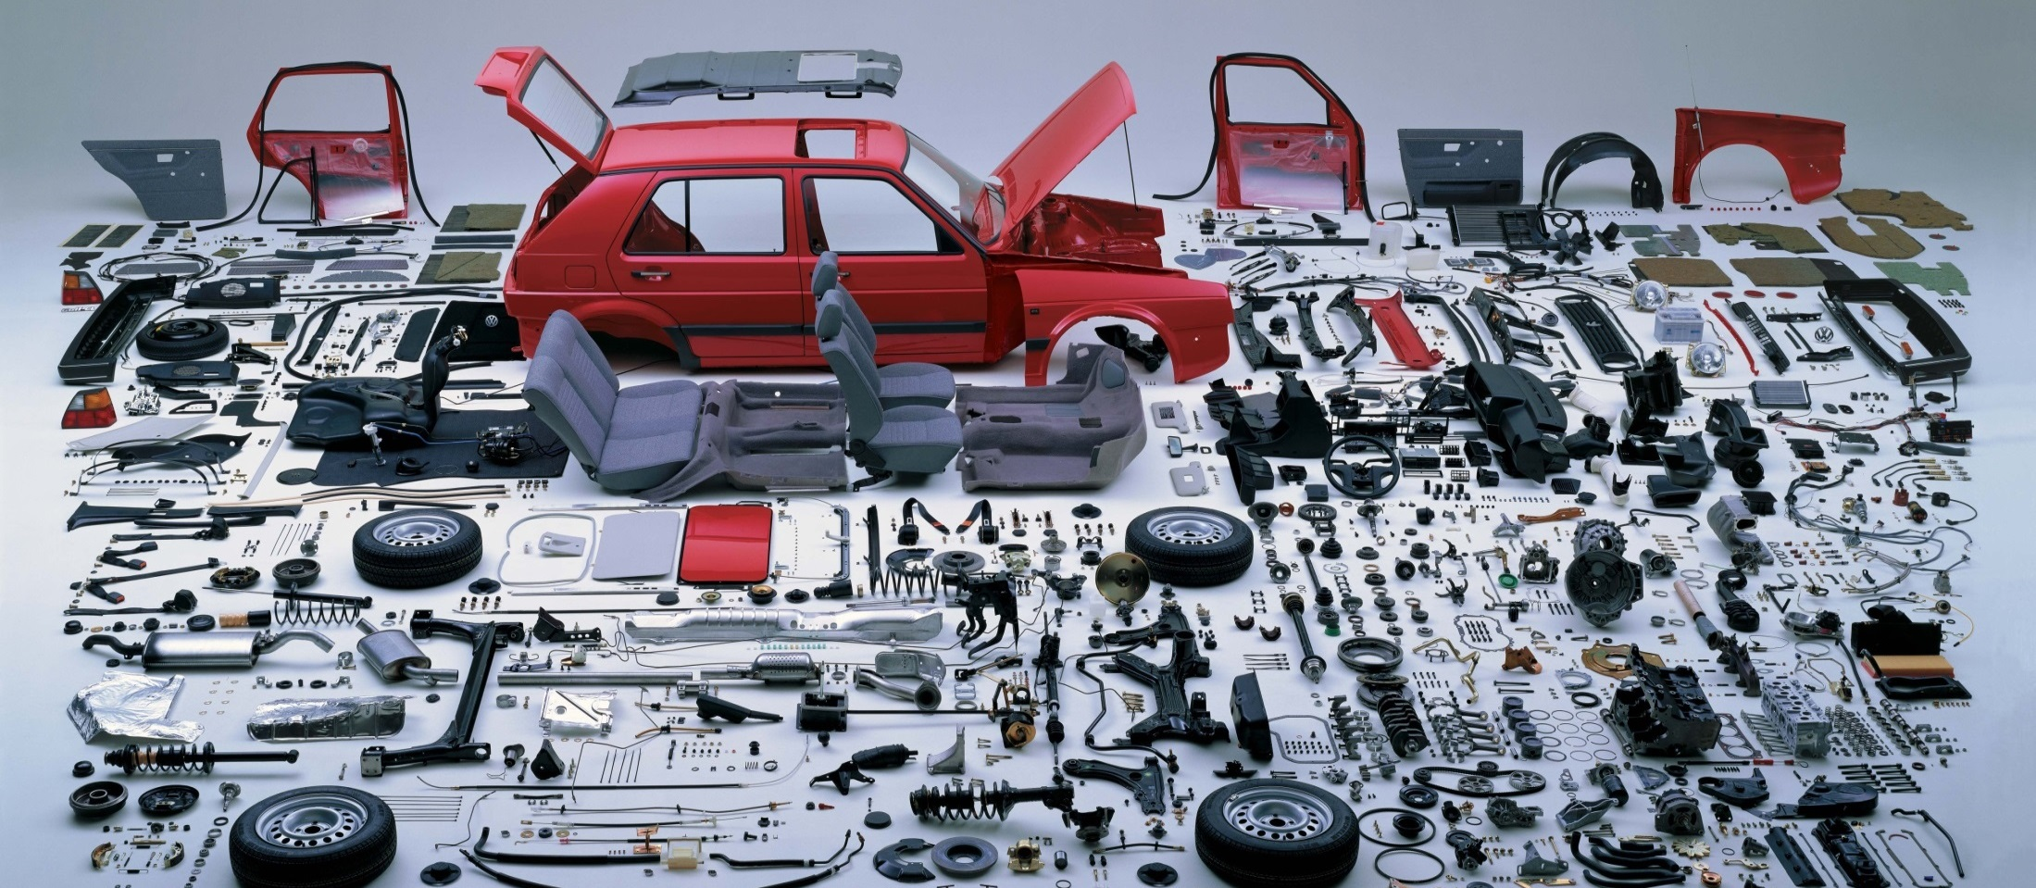
Car manufacturing
30,000+
Parts
8,600+
Equipment's
2,500+
Suppliers
200,000 +
People
A Complex Eco System

Slide 5



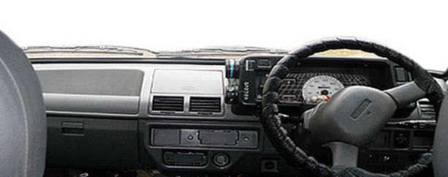
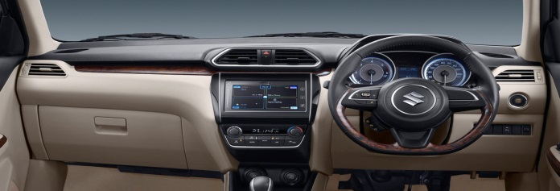
Change in Customer Era
Basic Vehicle
Smart Vehicle
+
Smart - Connected Vehicle
Increase in Complexity
1983
2017

Slide 6
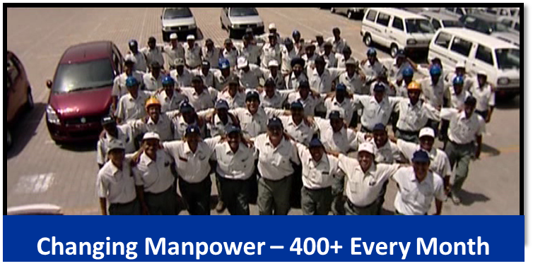

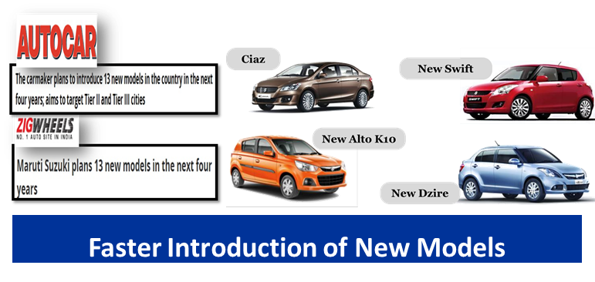
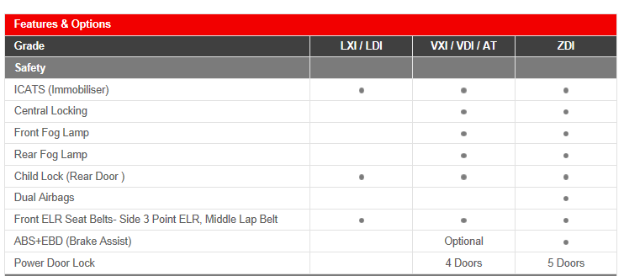
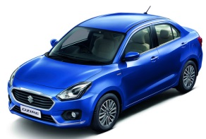
Challenges : Increasing Variability
Mix of New & Skilled Manpower
Changing Technology in new models
Variants – 400+ in upcoming Models

Slide 7
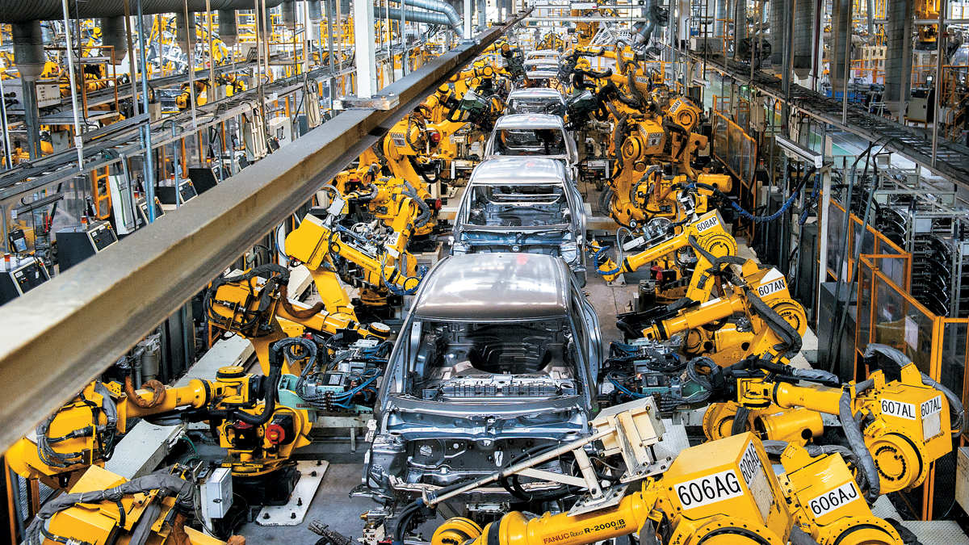
Made Possible by
Smart Manufacturing

Slide 8
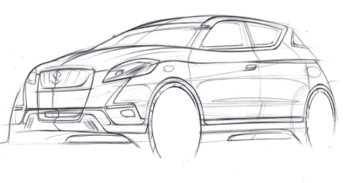
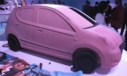
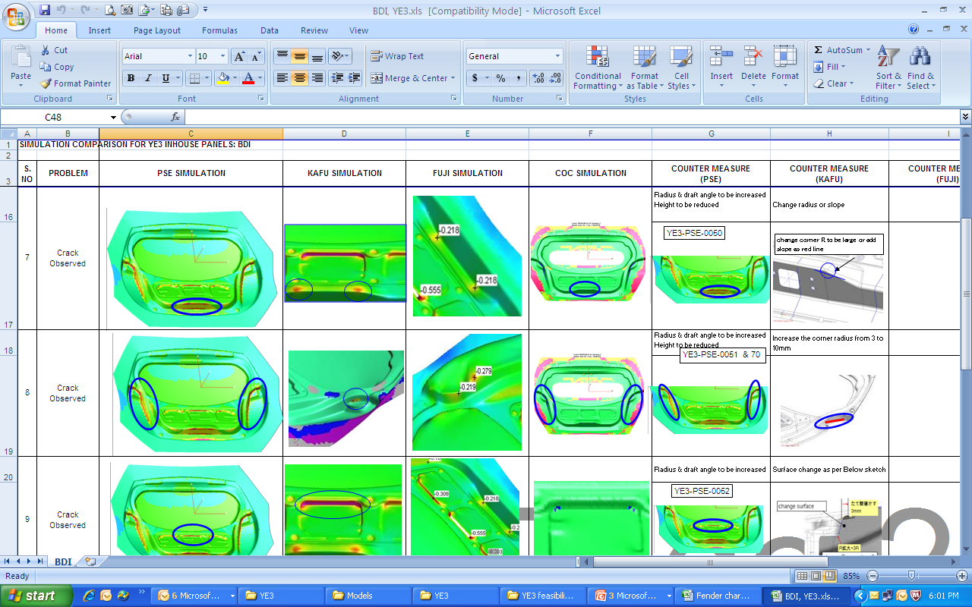
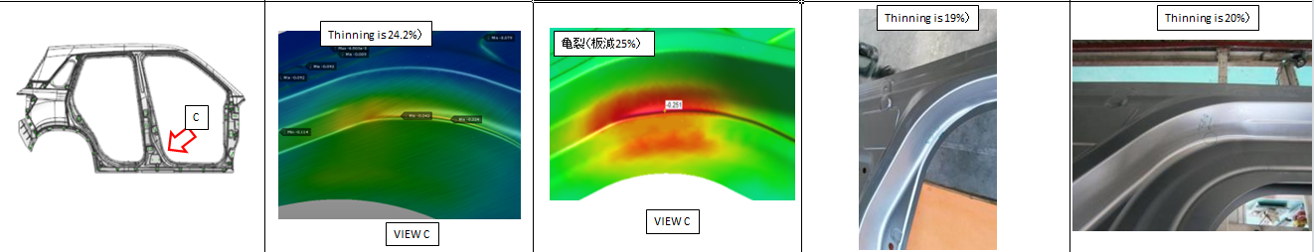
PRESS: Pre-Drawing Release process
Sketch Model
Clay Model
Formability CAE
DRAWING
RELEASE
Part CAD data
MSIL CAE

Slide 9
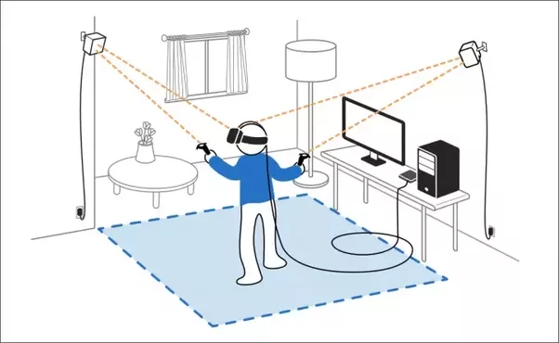
Virtual Reality for Digital Mock Up (DMU)
check for Manufacturability
Immersive Visualization of Processes and Issues, difficult to judge in 2D Screen
Checking Accessibility & Ergonomics
Checking Operator’s Point of View
3D Plant Walk through
Digital Pre Assembly checking at SMC, Japan

Slide 10
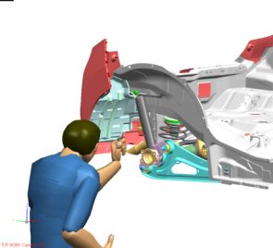
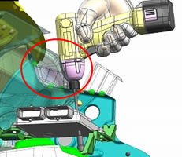
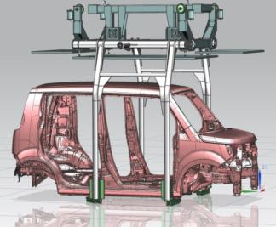
New Model Quality
Digital Mock up – Virtual Manufacturability
Enhancing Quality & Reduction in Lead time

Slide 11
3D Printed Parts for Responsive Manufacturing
Weld Parts for Robot Teaching
Jig for Bumper Painting
40 KG
12 KG
Intricate Design parts
Model intro time reduction
Improved Jig accuracy
Weight Reduction
Wind Shield Checking fixture

Slide 12
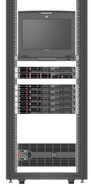
WICS (Weld Information Collection System)
Raw
Data
Processed
Data
OK Spots
NG Spot
Production Line
IT Based system
Centralized Quality Monitoring
Quality & Count Check for more than 2500 Weld Spots in each Vehicle
Notes:
Another example of leveraging IT based technology for monitoring Quality is of WICS (Weld Information Control System).
In a weld body, there are around 2500 spots. It is difficult to check all spots in all vehicles Manually. Weak weld spot may lead to body failure and serious safety issues.
So, we started checking weld spot strength with the help of Resistance as parameter. And in case of any abnormality, line stops

Slide 13


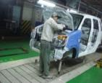
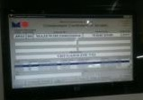
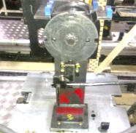
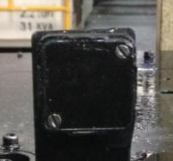
Part Traceability
Backend Traceability
Front Traceability
Linkage
Part
Vehicle
Vendor End
MSIL End
Scanning of Part
Traceability Info.
Storage of Info. in MSIL Database
Part Info. Linkage with Vehicle Chassis No.
RFID Tag
Notes:
In order to take care of this we have strong Traceability process in place.
And not just that Maruti end but we have also extended it to vendors part end.
All this information of vehicle manufacturing (line,date,shift etc) is linked with chassis details for traceability

Slide 14
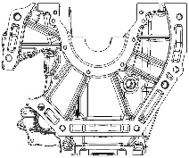
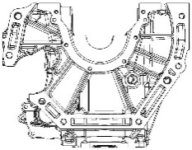
Process Traceability
Casting shop
M/cing
Report
Instant Feedback about
casting problems
NG Part details
Data recording – critical areas
Machine shop
Capturing Of Process Parameters
Input in Line
Leak Testing
Inline SPC, Press-fit, Nut runners & CMM
Final Measuring
Engine Assembly
Notes:
And we are not just limited to part traceability, we have extended it to process level, For capturing critical process parameters.
If in case some abnormality occurs, we can trace the process parameter like torque, fitting force, dimensional measurement, etc.

Slide 15

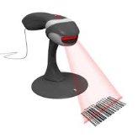


Process Traceability
Vehicle will not pass
Not OK
100134679
All Ok
AB OK INTERLOCK : Tightening, Filling & VCD Equipment
Notes:
Also, vehicle is interlinked in a way that in case of any abnormality, it will not be able to pass through final AB-ok or quality gate.

Slide 16
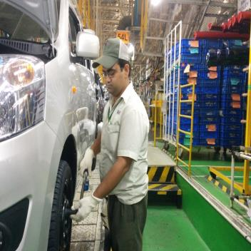
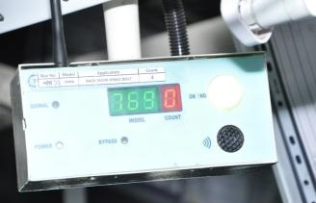
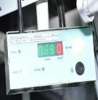
Building Robust Processes
Limit-Wrench Poka-Yoke in Assembly Shops
Interlocking with Number of Counts
Interlocking with Number of Counts
Fool-proofing of 100% Critical Nuts/Bolts Done
Poke-Yoke : 3,100 +
Notes:
Building quality in processes means making processes mistake-proof or Catching defect before it goes to next process.
We have different categories of Poka-Yoke or Fool-proofing done :
- Correct part picking for different variant, Eg. Lxi , Vxi etc
- Correct Part fitment, Eg. Emblems, Crank Cap Bearing
- Picking of correct part based on colour, Eg. Rear view Mirror
- Usage of correct jig, Eg. Different engine mount for different Engine
- Usage of correct bolt Eg. Sensors to check different bolt length for Hub Bolt pressing
And not just this, foolproofing in terms process done correctly eg : bolt tightening.
If all bolts have been tightened by number of counts & tightened with right torque value. We have installed CLW Cordless Limit wrench. We have 100% foolproofing for all critical nut & bolts.

Slide 17
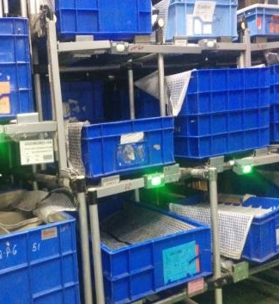
Building Robust Processes
Correct Part Picking Pika-Pika
Policy
Adherence
Critical to Quality
More Variants
Similar looking parts
Inner parts
Line Stops in case of Wrong Pick
Pika - Pika
Pika-Pika : 2000+
Line Stops in case of Wrong Pick
Notes:
Building quality in processes means making processes mistake-proof or Catching defect before it goes to next process.
We have different categories of Poka-Yoke or Fool-proofing done :
- Correct part picking for different variant, Eg. Lxi , Vxi etc
- Correct Part fitment, Eg. Emblems, Crank Cap Bearing
- Picking of correct part based on colour, Eg. Rear view Mirror
- Usage of correct jig, Eg. Different engine mount for different Engine
- Usage of correct bolt Eg. Sensors to check different bolt length for Hub Bolt pressing
And not just this, foolproofing in terms process done correctly eg : bolt tightening.
If all bolts have been tightened by number of counts & tightened with right torque value. We have installed CLW Cordless Limit wrench. We have 100% foolproofing for all critical nut & bolts.

Slide 18
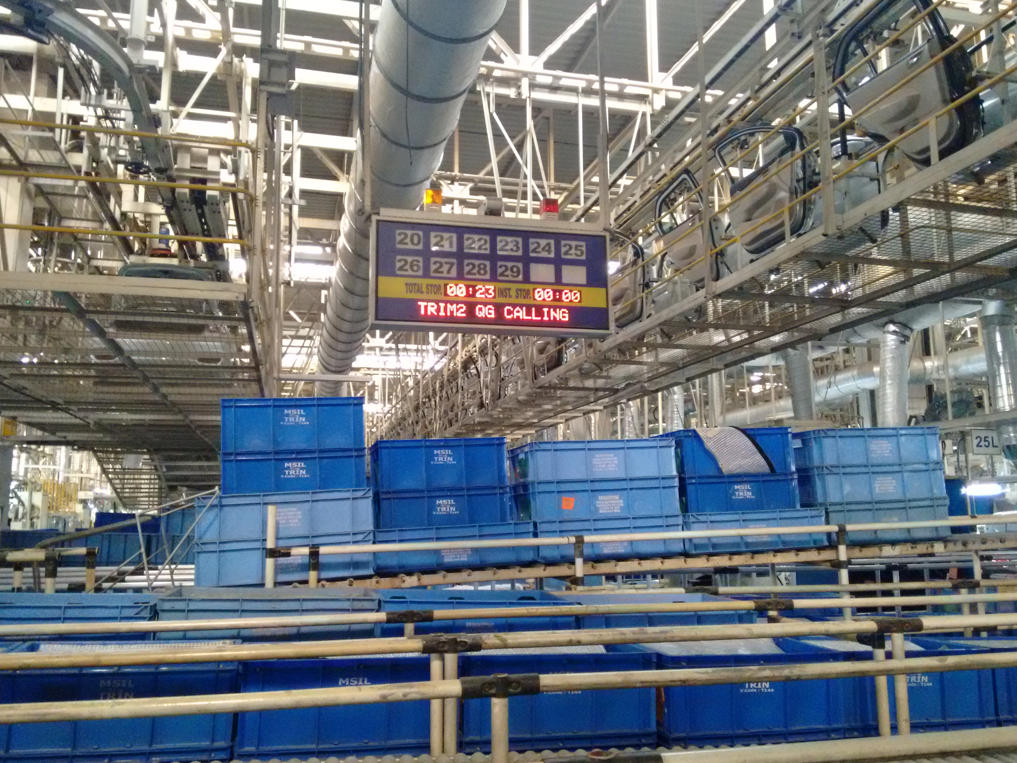
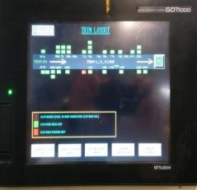
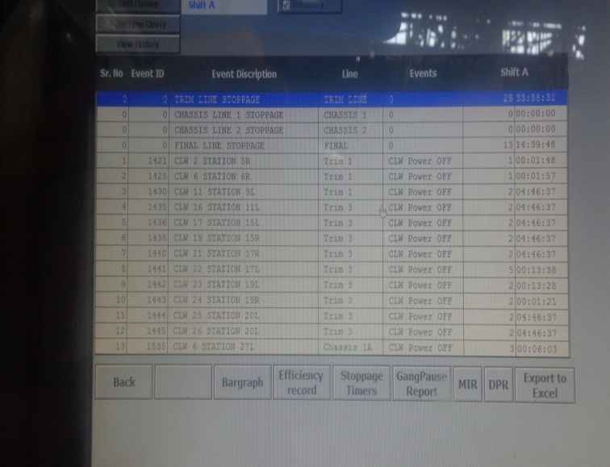
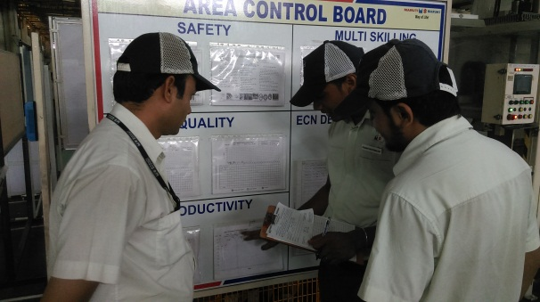
Building Robust Processes
ANDON System
(Line Stoppage → Station Connected to Controller → Andon Display)
Daily Analysis
Monitoring by Plant Managers
Data Capturing
Notes:
We have fool-proofing across all areas & processes. The purpose is not for Policing, but to ensure no process gets missed by mistake.
For ex : we have sensors to detect if oil has been used or not.
Then we have lot of focus on Visual controls. Andon boards are installed to show where & why default has occurred for Supervisor to check.
And same is highlighted in the office area for Plant Managers to check. Check on check is embedded into all our processes.

Slide 19
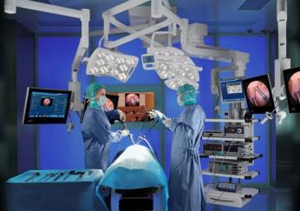
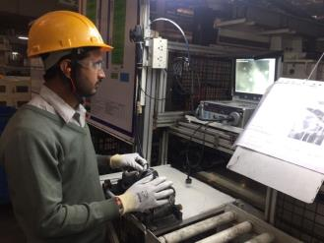
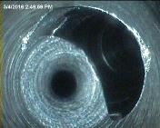
Building Robust Processes
Medical Science Tools application to Manufacturing
ENDOSCOPE INSPECTION: The Chip Doctor
Notes:
Innovation is also applying solution from other areas, eg : We adopted Endoscopy inspection used in Medical science in our Manufacturing for seeing the chips in engine oil galleries.
It is very difficult to trace chips / burrs with eye & its presence may lead to engine seizure.
So, we introduced endoscopy tool as it can be inserted into oil galleries & with the help of camera we can detect presence of any chip/burr.
We call it as Chip Doctor ☺ ☺

Slide 20
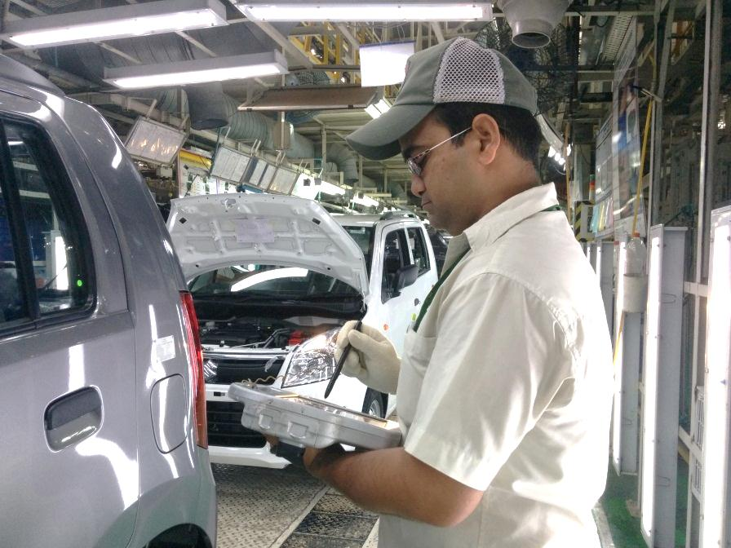
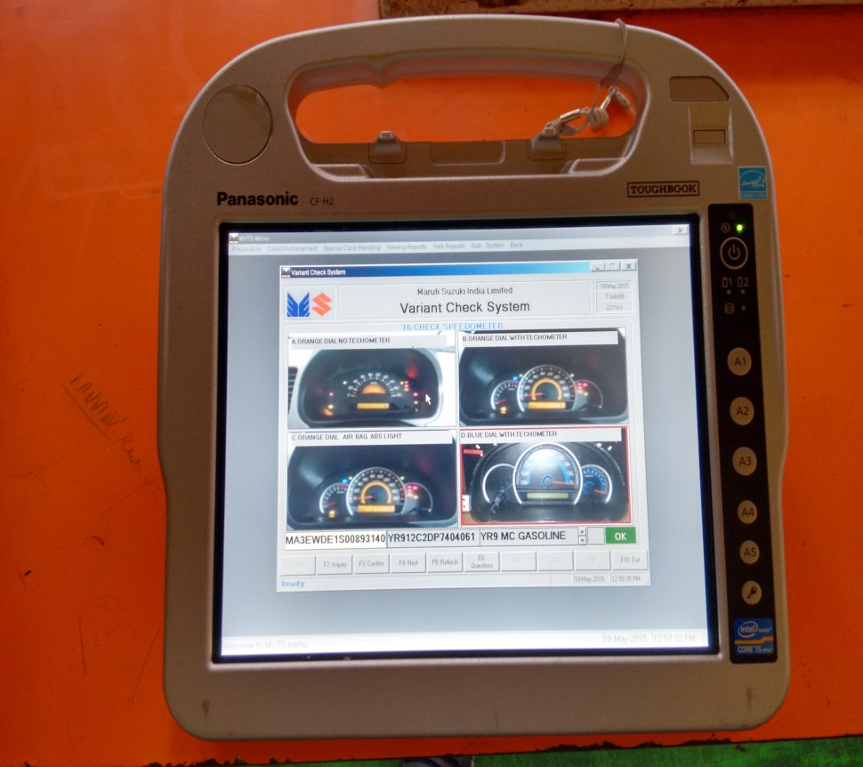
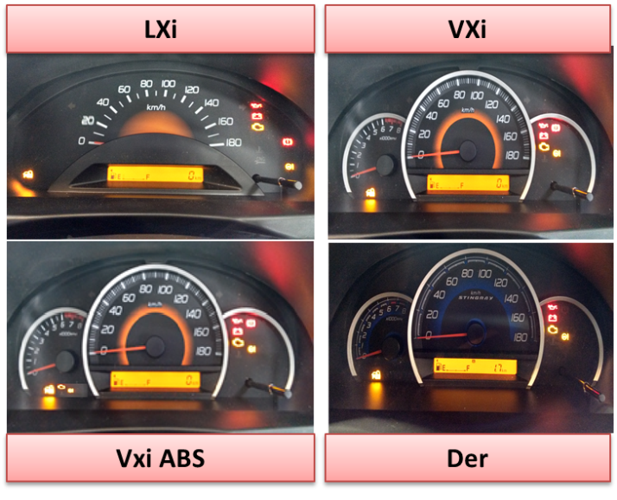
Tablets for Variant Check in Vehicle Inspection
100 % Vehicle Inspection
350 + checks per vehicle
200 + variants of a Model
Notes:
With increasing number of models & its variants.. For eg : Baleno has variants more than 1000 nos.
It is very important to induce technology into processes, link it to IT system or server.
For eg : in Vehicle Inspection area which is a very critical area, we have started using Tab to see the check points along with values/parameters corresponding to Model variants

Slide 21
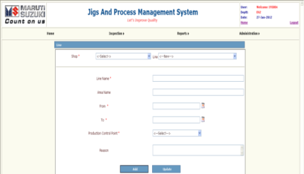
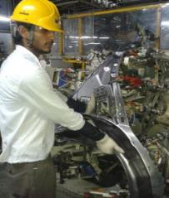
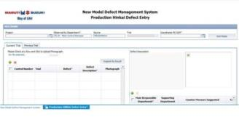
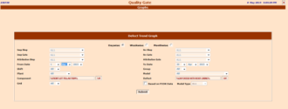
Jig & Process Management System
Enormous Data generated during the Process
New Model Defect Management System
Jig & Process Management System
System driven schedule for timely Quality Maintenance
Quality Gate System
Interlinking Data with IT Systems for controlling Quality
Notes:
Maintaining quality is another important aspect.
We have built a system which prompts for life completion of wear parts & requires replacement to ensure quality.
Then we have built multiple IT based systems for recording defects, countermeasure taken which becomes handy in future.

Slide 22


